Slide 1

Revolutionizing Digital Financial Services in Bangladesh
Name : Mst Fahmida Khatun
Department : Economics
Id No :01-022-24
Batch : 22
Date :5-9-2024

Slide 2
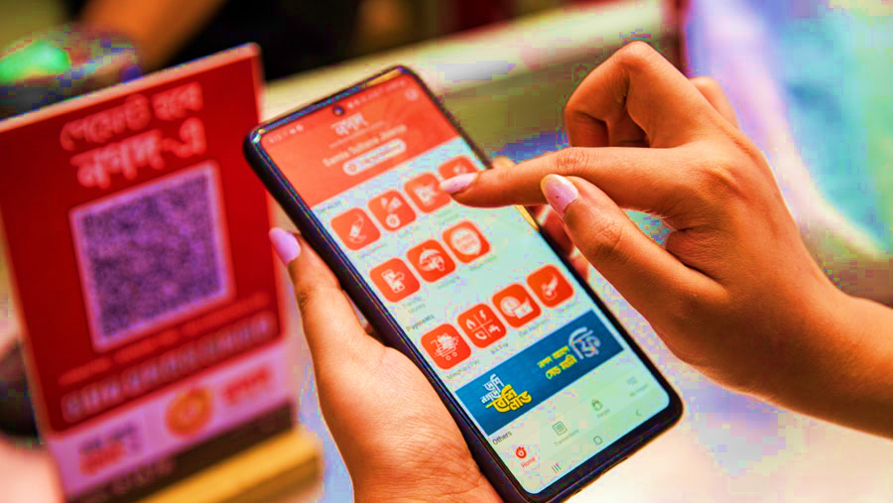
INTRODUCTION
Nagad is a mobile financial service provider in Bangladesh, launched by the Bangladesh Post Office in 2019.It offers a wide range of financial services, including:
Cash deposits and withdrawals
Money transfers
Bill payments
Mobile recharge
Online shopping
Nagad aims to promote financial inclusion and digitalization in Bangladesh.

Slide 3

SERVICES
Mobile wallet
Bill payments
Money transfer
Mobile Recharge
Cash in
Cash out
Insurance policy
Help line
Marchant pay

Slide 4
KEY PERFORMANCE INDICATORS
Month | Transaction Volume (BDT) | New Customers
January | 500,000,000 | 200,000
February | 550,000,000 | 220,000
March | 600,000,000 | 250,000

Slide 5
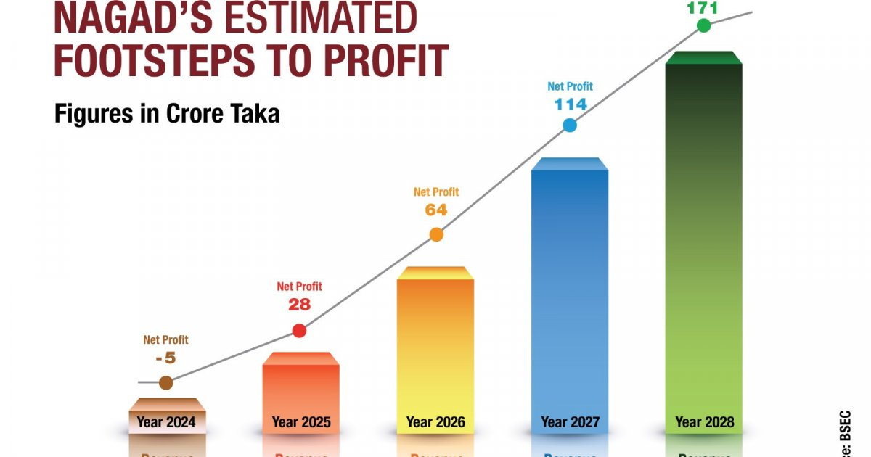
FUTURE PLAN
Market Expansion:
Target underserved rural areas.
Explore neighboring countries.
Product Enhancement:
Introduce AI-driven services.
Upgrade mobile app for better UX.
Customer Engagement:
Launch loyalty and referral programs.
Conduct financial literacy workshops.
Marketing Strategy:
Implement targeted digital campaigns.
Collaborate with local influencers.
Financial Goals:
Aim for X% revenue growth.
Seek partnerships for funding.
Risk Management:
Invest in advanced cybersecurity.
Conduct regular market analysis.

Slide 6

FINAL THOUGHT
Established as a leader in mobile financial services in Bangladesh
Significant customer growth and transaction volume in a short period.
Focus on underserved populations.
Enhancing access to financial products for economic empowerment
Commitment to promoting cashless transaction
Aligning with the government's goals for economic efficiency and transparency
Integration of AI and machine learning for competitive advantage.
Improving service delivery and enhancing customer experience.
Future Prospects Plans for digital banking and service expansion
Strong positioning for continued growth and adaptation to market needs.

Slide 7

nagad service center

Slide 8

THANK YOU

